Slide 1


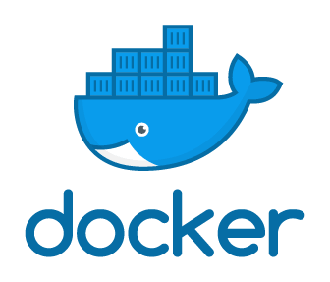

(BCSE 0456) DevOps

Slide 2
AGENDA
Hands on docker

Slide 3
DOCKER COMMANDS
Docker –help |less

Slide 4
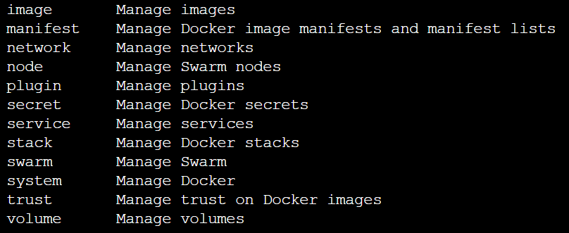
DOCKER COMMANDS
Parent Module

Slide 5
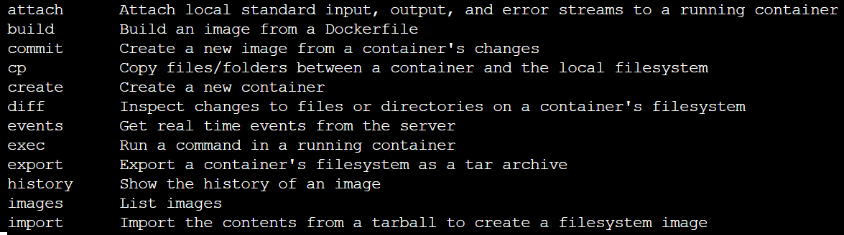
DOCKER COMMANDS
Child Module

Slide 6
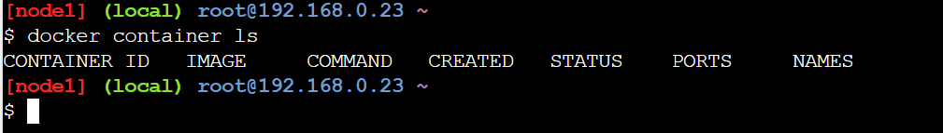
DOCKER CONTAINER COMMANDS
Docker container ls

Slide 7

DOCKER IMAGE COMMANDS
Docker image ls

Slide 8
DOCKER CONTAINER COMMANDS
Old way of commands
Docker ps:
For running containers

Slide 9
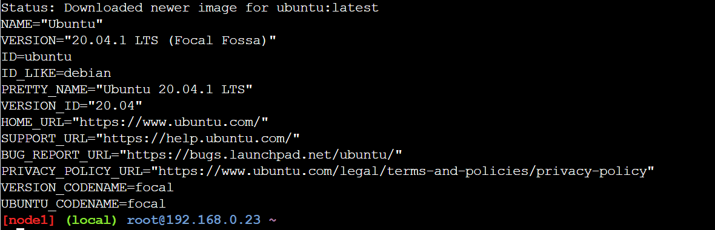
DOCKER CONTAINER COMMANDS
Docker container run ubuntu cat /etc/os-release

Slide 10
DOCKER CONTAINER COMMANDS
Docker container ls
Now there is nothing in container because we have executed this command and exit from the container.

Slide 11
DOCKER CONTAINER COMMANDS
Docker container ls -a

Slide 12
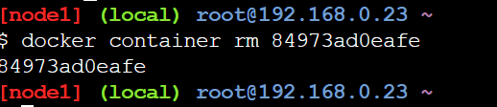
DOCKER CONTAINER COMMANDS
Docker container rm container_id
Docker container rm 84973ad0eafe
Docker container rm 84
Docker container rm container_id1 container_id2

Slide 13


